Slide 1
ELE 408
Sense-Hat Controlled Pictionary Game
By Johann Muller and Nicholas Clavette

Slide 2
Project Description
Pictionary is a drawing and guessing game, where teams alternate turns.
Each turn, one player from a given team will be assigned something to draw.
As the drawer is drawing, their teammates must guess what is being drawn.
If the team guesses correctly in the time allotted, they get a point.

Slide 3
Project Description
We will use data from Raspberry Pi SenseHat IMU to correlate drawing on the PC screen.
A GUI will allow the user to calibrate the Sense Hat
A web page will host teams, and provide an interface to guess the drawing.

Slide 4
Project Motivation
Helps increase social interactions
Lots of space to incorporate machine learning
Provide a new fun way to play Pictionary

Slide 5
Hardware Requirements
Raspberry Pi 4
Sense Hat
A computer with internet access

Slide 6
GUI Program
A graphic user interface to assist calibrating the Sense Hat’s orientation data to the desired range of motion

Slide 7
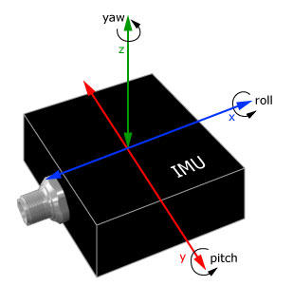
Socket Programming
TCP connection to transmit the image
TCP connection to transmit the IMU data

Slide 8
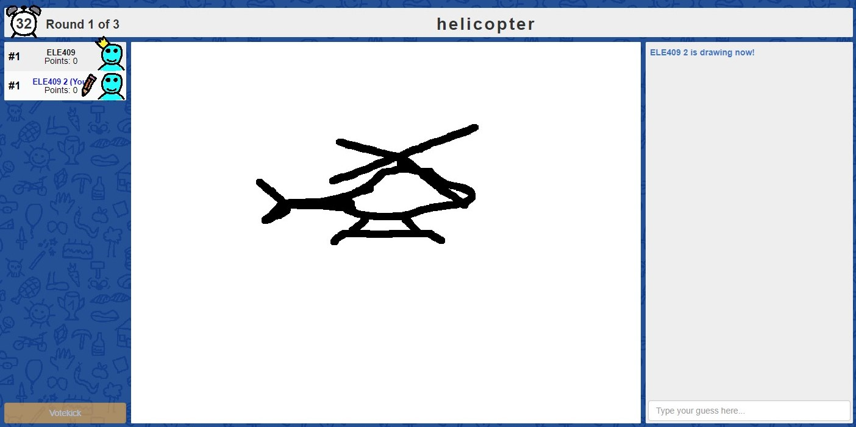
Web Interface
Multi-user chat where team members will try to guess what their team-mate is drawing
* from scribbl.io

Slide 9
Machine Learning
Incorporate learning gesture recognition to construct smooth shapes
Improve accuracy of Raspberry Pi orientation mapping to pixels on the screen

